Slide 1
QA Automation Case Study
Insights and Learnings
Stephy Saji Daniel
Dec 14,2023
Notes:
Hello everyone , Thankyou for joining. Myself stephy saji daniel

Slide 2

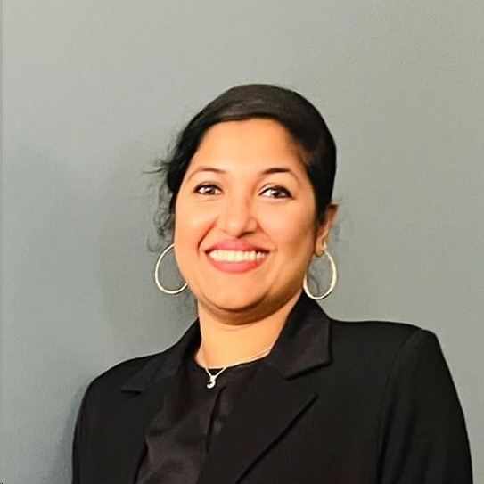
STEPHY SAJI DANIEL
B.TECH in Electrical & Electronics Engineering
Past Experience : Lead Engineer at HCL Technologies Pvt. Ltd
AWS Certified Cloud Practitioner
Notes:
I’m based out of Texas, I’m passionate about Technology & I write technical Blogs in Medium . In my freetime I do abstract paintings and spend time with my twins.

Slide 3
TECHNOLOGIES
01. FRONT-END LAYER
02. BUSINESS-LOGIC LAYER
HTML
CSS
JAVA SCRIPT
JAVA
JDBC
03. BACK-END LAYER
04. TESTING FRAMEWORK
05. CI/CD
06. VERSION CONTROL
MYSQL Server & WorkBench
JUNIT
SELENIUM
TESTNG
JENKINS
GIT
Notes:
During my 4 month journey with PerScholas I have learned and implemented html, java, mysql, testing framework and Jenkins for continuous integration

Slide 4

Ecommerce Web UI Testing Case Study
Notes:
Today I want to demonstrate UI Test Automation for ecommerce web application

Slide 5
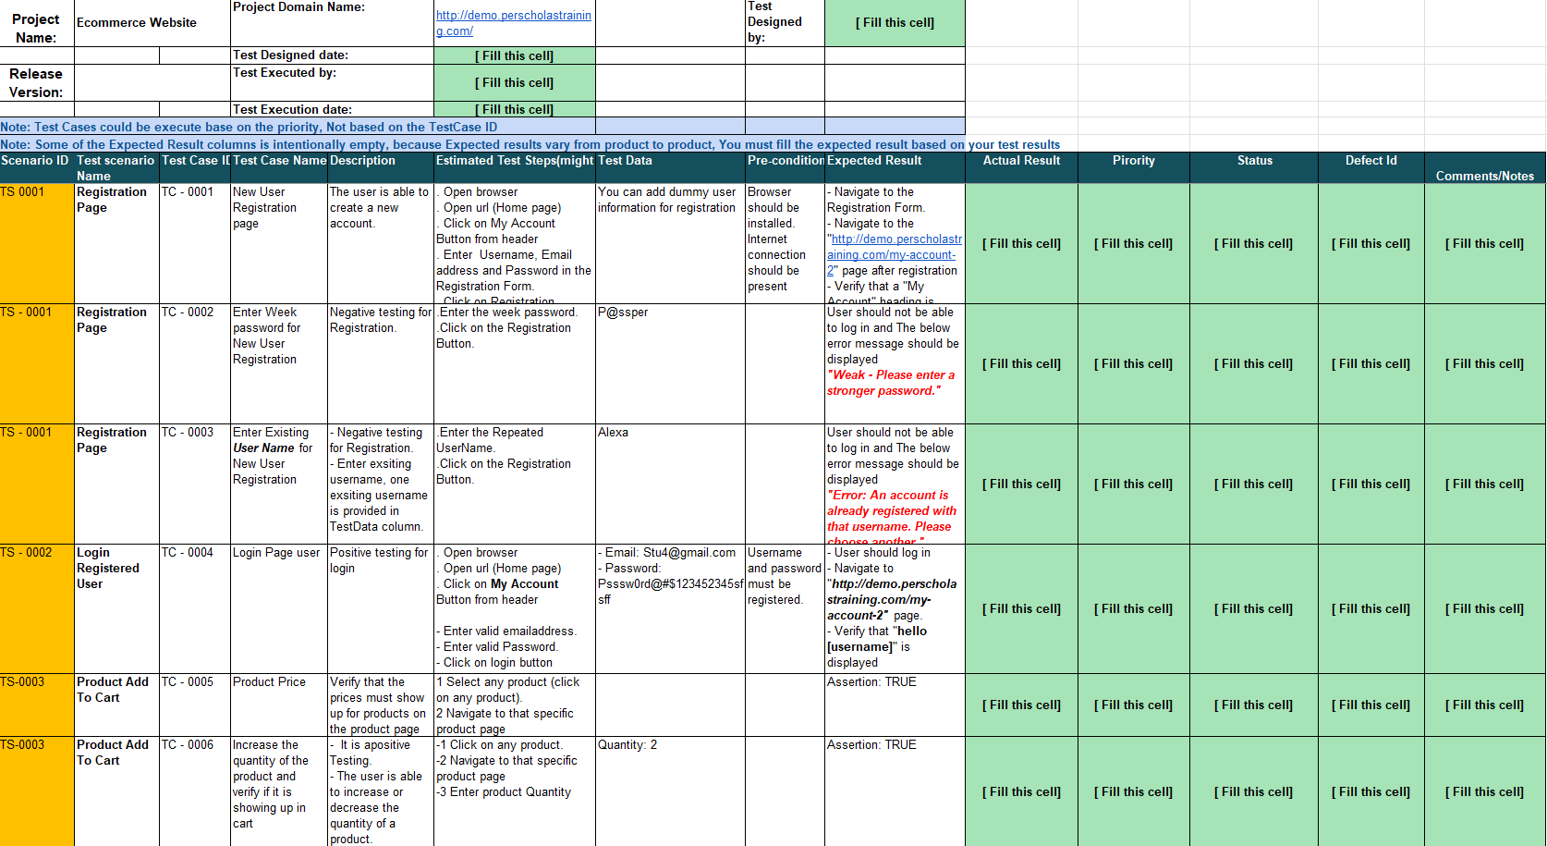
Test Case Document
Test output
User Interface Test Requirements
Notes:
This is the test case requirements document , which contains the test scenarios , test cases , test step and expected result.----click ------
Test output will be updated post test validation .

Slide 6
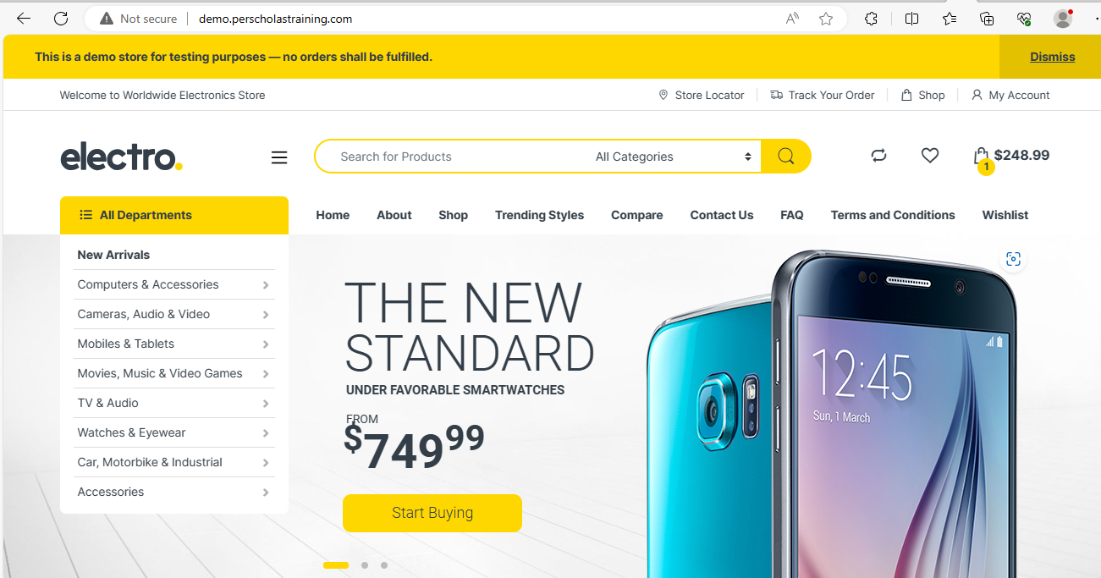
Wire Frame :Electro Web Application
Main Pages
Notes:
This is the main page of ecommerce website. Lets say user want to add a product and they need to navigate to Product page

Slide 7
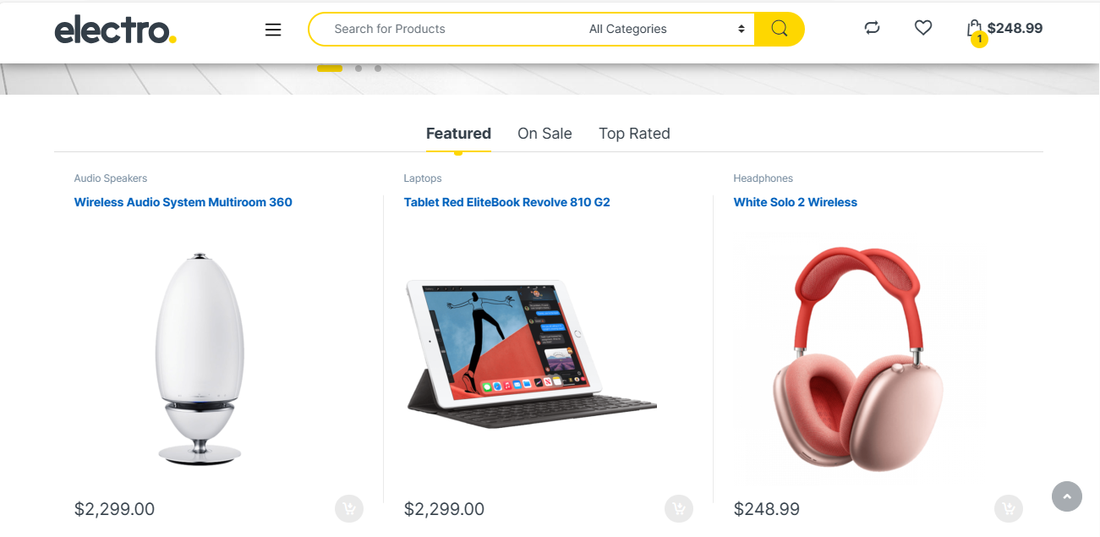
Wire Frame :Electro Web Application
Product Pages
Notes:
and In the product page, user can select any products of their choice

Slide 8
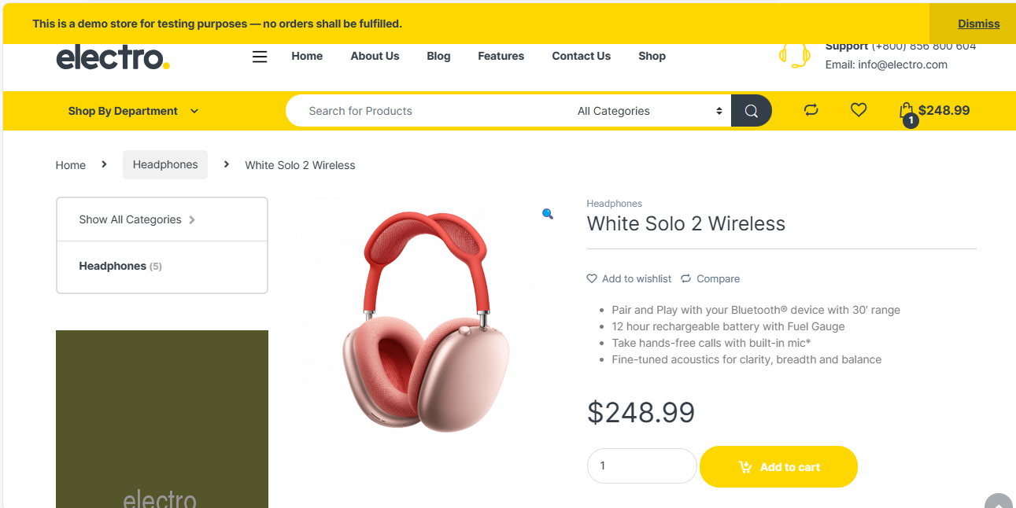
Wire Frame :Electro Web Application
Test Scenario
Product Add to cart Pages
Notes:
The User want to add the selected product to the cart . This is the first test scenario I am going to demonstrate today

Slide 9
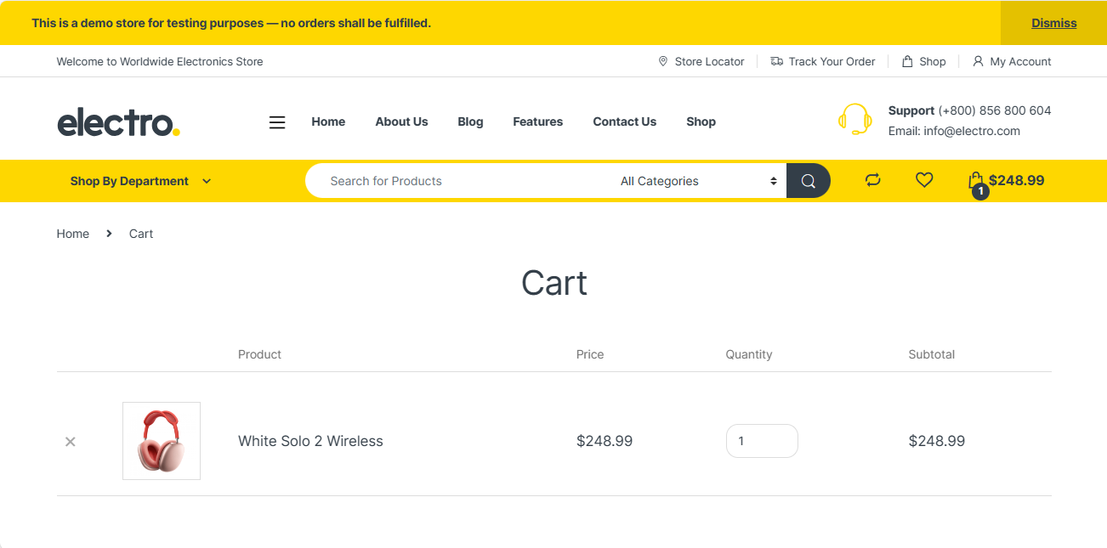
Wire Frame :Electro Web Application
Test Scenario
Shopping cart Pages
Notes:
And my second test scenario is to validate Shopping cart pages

Slide 10

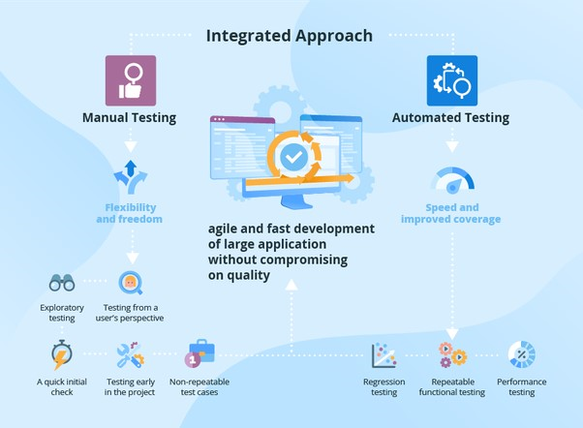


UI Testing: Integrated Approach
Manual Testing
Selenium + Java
Automation Testing
Selenium + Java +TestNG + Maven
Page Object Model from Selenium
Notes:
Using a combination of manual and automated testing is the most effective way to catch the highest number of bugs and defects.I am going to demonstrate manual test approach I have done for Product Add to cart Pages.

Slide 11
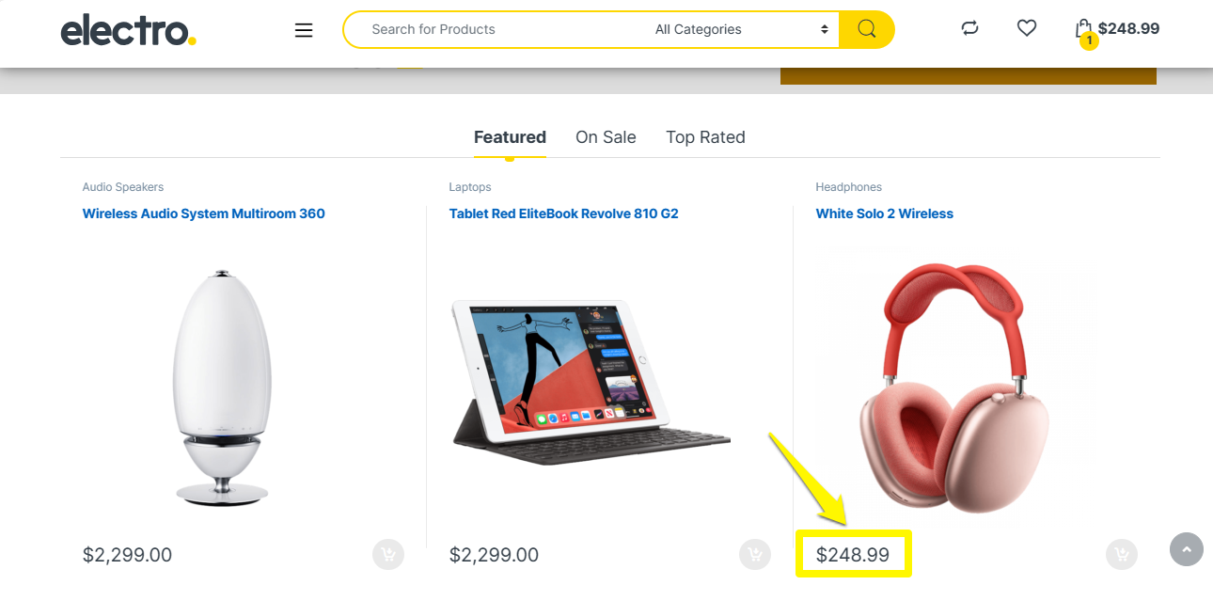
Manual Testing: Product Price
Scenario ID | Test scenario Name | Test Case ID | Test Case Name | Description | Estimated Test Steps (might be more or less) | Test Data | Pre-condition | Expected Result
TS-0003 | Product Add To Cart | TC - 0005 | Product Price | Verify that the prices must show up for products on the product page | 1 Select any product (click on any product). 2 Navigate to that specific product page |  |  | Assertion: TRUE
TEST ACTIONS
Verify the Product price
Select any product (click on any product)
Navigate to that specific product page
Notes:
In this testcase, I need to verify if a user can view the product price .

Slide 12
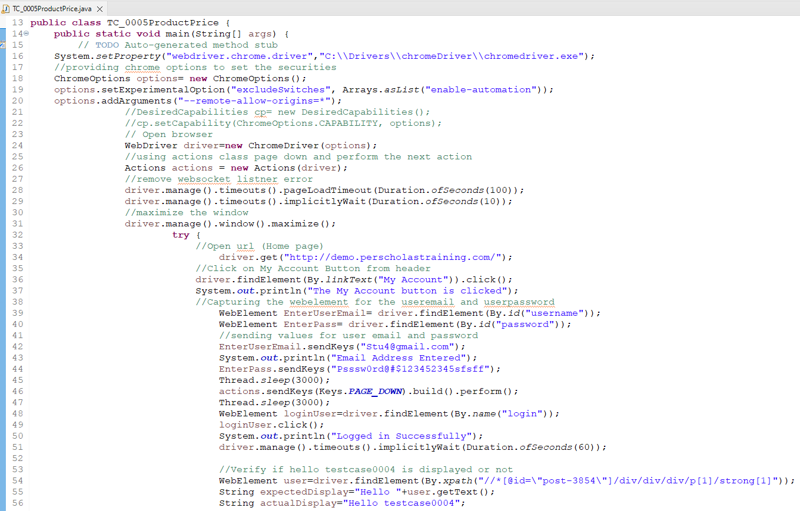
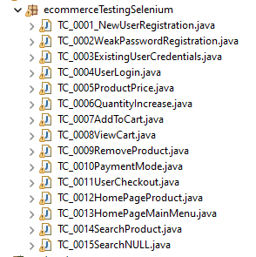

Testcase: Implementation
MANUAL TESTING
1
UTILITIES
2
TEST ACTIONS & ELEMENTS
3
TEST VALIDATION
Notes:
This is the manual test case folder structure .Here ,user will login to the application running in chrome browser ---click----and navigate to the product page to check the product price. The section 1 has browser selection, 2 for identifying elements and methods , 3 for test case validation.
Polymorphism
************In this testcase All the utilities, dependent files, class methods ,
web elements and test verification is created on one class its not scalable and reusable to other testcases in a larger perspective .
I have written conditional statement to do manual testing and later used junit assertions to perform testing

Slide 13
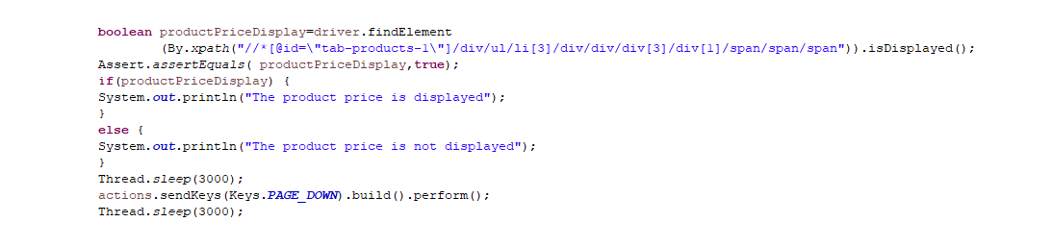
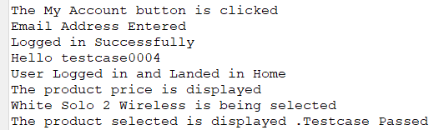
Testcase: Implementation
MANUAL TESTING
1
UTILITIES
TEST VALIDATION
2
MANUAL TESTING OUTPUT
Notes:
The first block of code inspects the product price by element locator x-path and validates , using if else statements to verify whether it is displayed or not ,later I have added Junit assertions . The second block of code is the console output that shows the testcase is passed.

Slide 14
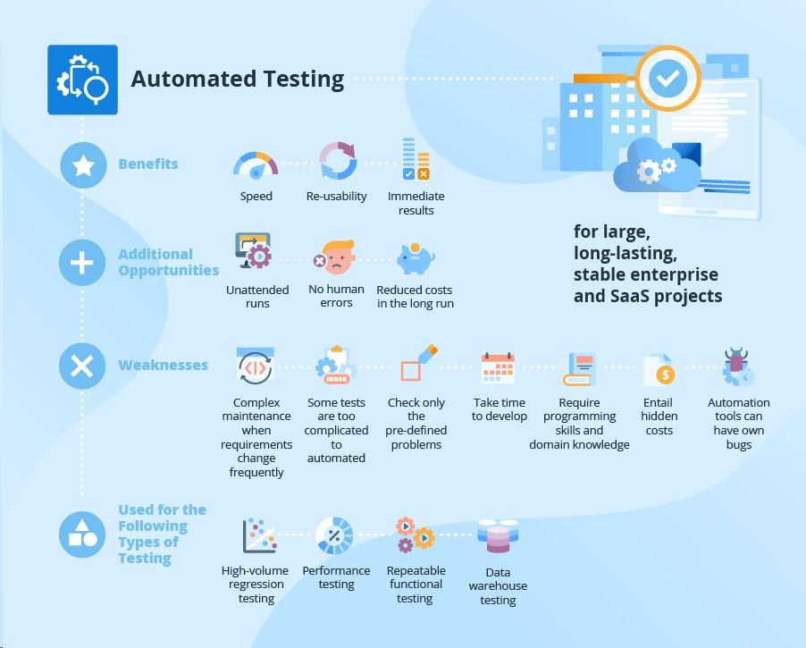
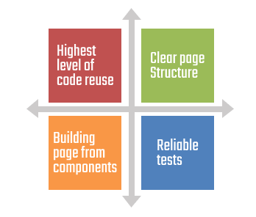
Automation Testing :Page Object Model
POM MODEL BENEFITS
Notes:
In the automation test approach Im using Page Object Model

Slide 15
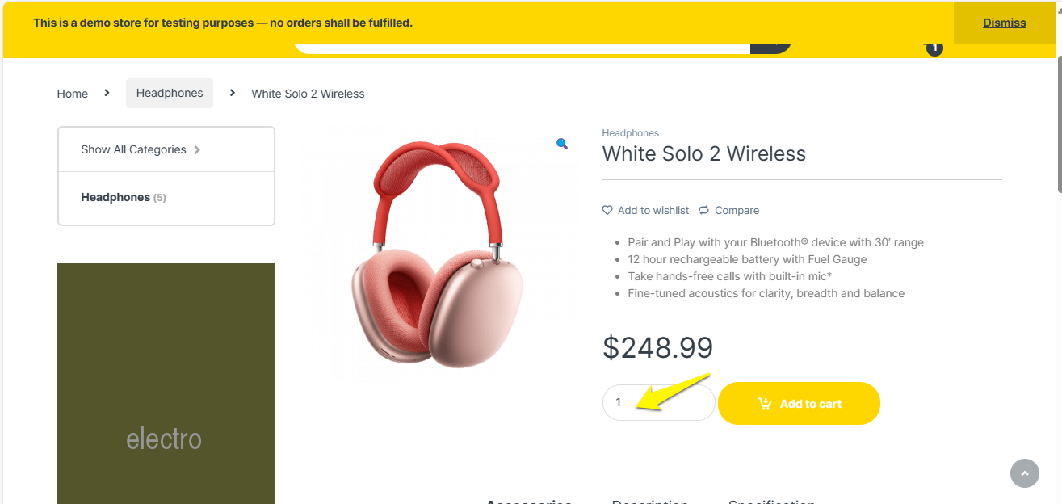
Test Automation: Product Quantity
Scenario ID | Test scenario Name | Test Case ID | Test Case Name | Description | Estimated Test Steps (might be more or less) | Test Data | Pre-condition | Expected Result
TS-0003 | Product Add To Cart | TC - 0006 | Increase the quantity of the product and verify if it is showing up in cart | - It is a positive Testing. - The user is able to increase or decrease the quantity of a product. | -1 Click on any product. -2 Navigate to that specific product page -3 Enter product Quantity | Quantity: 2 |  | Assertion: TRUE
TEST ACTIONS
Click on any product.
Navigate to that specific product page.
Enter product Quantity.
Notes:
and these are testcases , test if user can increase product quantity
###Product Quantity , The we need to view the cart
Provides Object Repository for web elements
Reuse the code from one page to another page.
Readability and Reliability
####When you think of a larger perspective here we have testcase 6 where u need to increase the product quantity which is dependent on testcase 5 as u cant directly come here and test h]

Slide 16
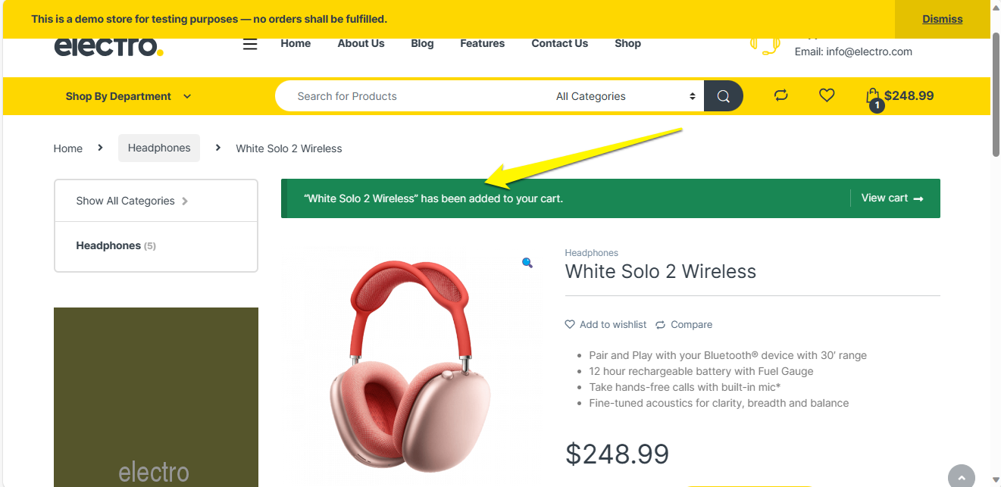
Testcase: Add Product to Cart
Scenario ID | Test scenario Name | Test Case ID | Test Case Name | Description | Estimated Test Steps (might be more or less) | Test Data | Pre-condition | Expected Result
TS-0003 | Product Add To Cart | TC - 0007 | Add Product to the cart and verify if product Is added to cart page | The user is able to add products to the cart by clicking on the “Add to Cart” (button). - Selected products should be added to the cart. - If product added to the card, below message will display on the screen [Product Name] has been added to your cart. - "View cart" button will enable on the same. | 1 Select any product. 2 Navigate to that specific product page 3 Select product option (brand, quantity, size if display on screen) 4 Click on Add to Cart button. | Select either One product or more than one product. |  | - If product added to the card, below message will display on the screen [Product Name] has been added to your cart. - "View cart" button will enable on the same.
TEST ACTIONS
Select any product. Navigate to that specific product page.
Select product option (brand, quantity, size if display on screen).
Click on Add to Cart button.
Notes:
Second testcase is to verify view cart is enabled to the user
Once the product quantity is increased I will be validating if the view cart is enabled for that product.

Slide 17
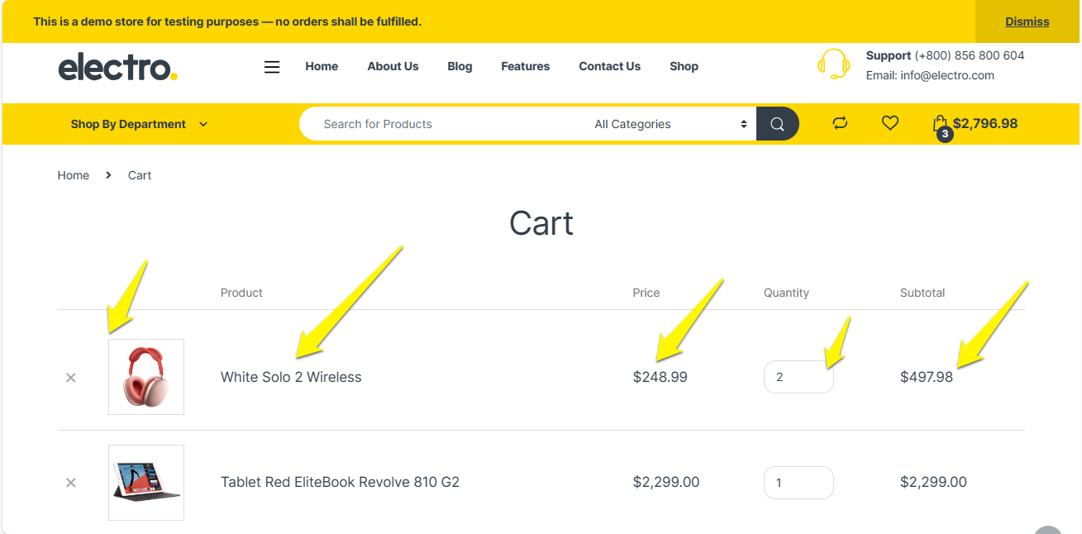
Testcase: View Cart
Scenario ID | Test scenario Name | Test Case ID | Test Case Name | Description | Estimated Test Steps (might be more or less) | Test Data | Pre-condition | Expected Result
TS-0003 | Product Add To Cart | TC - 0008 | View cart page | After Adding the product/products to the cart, On View cart page (http://demo.perscholastraining.com/cart/), Product's image, product name, quantity, price, subtotal and Total price must display on the screen. | 1 Select any product. 2 Navigate to that specific product page 3 Select product option (brand, quantity, size if display on screen) 4 Click on Add to Cart button. 5 Click on "View cart" button or View cart icon 6 Navigate to cart page | Select either One product or more than one product. |  | Product image, Product Name, Quantity, subtotal and Total must display on the screen Hint (Use findElements() method and soft assertions , hard assertions that save your time)
TEST ACTIONS
Select any product.
Navigate to that specific product page.
Select product option (brand, quantity, size if display on screen).
Notes:
Third testcase is to verify the products added in cart
In this testcase I have added two products in the product cart and validating the list of products in the cart.
All these steps are dependent on each other and by using page object model , it helps to reuse the methods and web elements.
#all these test cases are dependent to each other you need to a repetitive steps

Slide 18
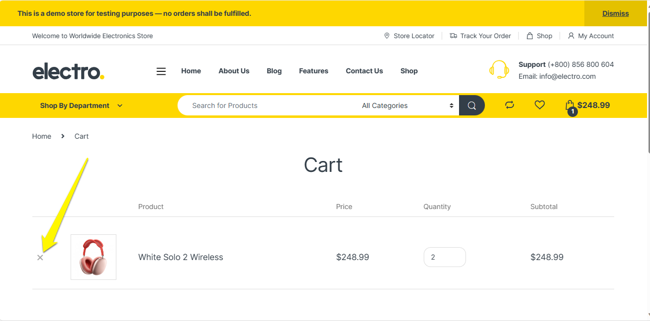
Testcase: Remove Product
Scenario ID | Test scenario Name | Test Case ID | Test Case Name | Description | Estimated Test Steps (might be more or less) | Test Data | Pre-condition | Expected Result
TS-0003 | Product Add To Cart | TC - 0009 | Remove Product from cart | Remove Product from cart: Verify that the Product should be removed from the cart and the Cart icon should show 0 items. | 1 Select any product. 2 Navigate to that specific product page 3 Select product option (brand, quantity, size if display on screen) 4 Click on Add to Cart button. 5 Click on "View cart" button or View cart icon 6 Navigate to cart page. 7 Click on "X" icon 8 Message "Your cart is currently empty." will show on the screen | - Select either One product or more than one product. - Zero Product show on cart page |  | -Product should be removed from the cart - Below Message will show on the screen "Your cart is currently empty."
TEST ACTIONS
Select any product.
Navigate to that specific product page.
Select product option(brand, quantity, size
Click on Add to Cart button
Notes:
And fourth testcase is to remove products in the cart

Slide 19
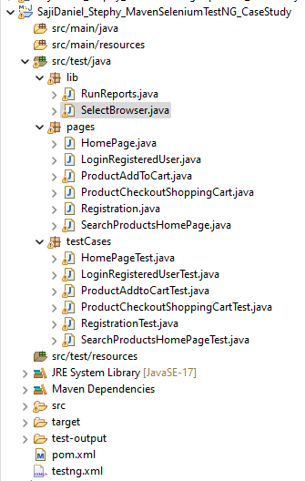
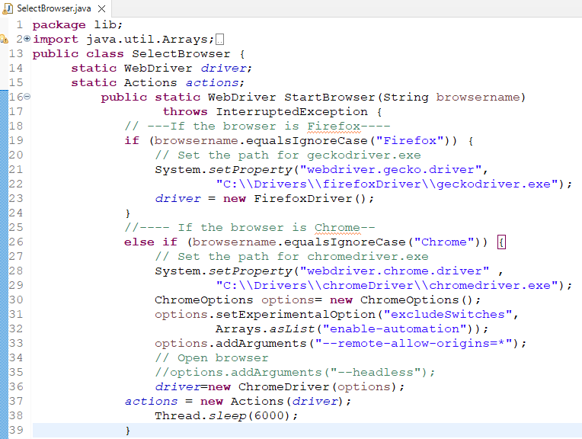

Test Scenario: Product Add to Cart
Page Object Model
UTILITIES
TEST ACTIONS &
ELEMENTS
TEST IMPLEMENTATION
TEST OUTPUT
CONFIG FILES
Notes:
This is page object model structure , where lib and pages has reusable object repository and reusable methods used in different pages.
This is the page object Model structure I have created for the case study. In lib package I have reusable methods for browser selection in selectbrowser class and methods to get screenshots in run reports class------click--------pages package has.the object repository of web elements & its actions which helps in maintenance &reusability, the dependent testcases are in ,one testcase class file in testcases package. The test output have the test reports , configuration files have maven pom.xml and testing.xml files
, I have created selectbrowser class where static WebDriver method ,launch multiple browsers like firefox , chrome and ie based on browser selected for execution. The reports class for methods to capture screenshots
By using POM, the test code for one screen, is reused in another test case. It is a design pattern in selenium that creates object repository for storing all web elements and its actions ----show pages
here I have created library folder for test output screenshots and browser selection The testcase folder consists of scenarios which has similar test steps to validate an element /functionality
Test implementation
There is no need to rewrite code, thus saving time and effort.

Slide 20
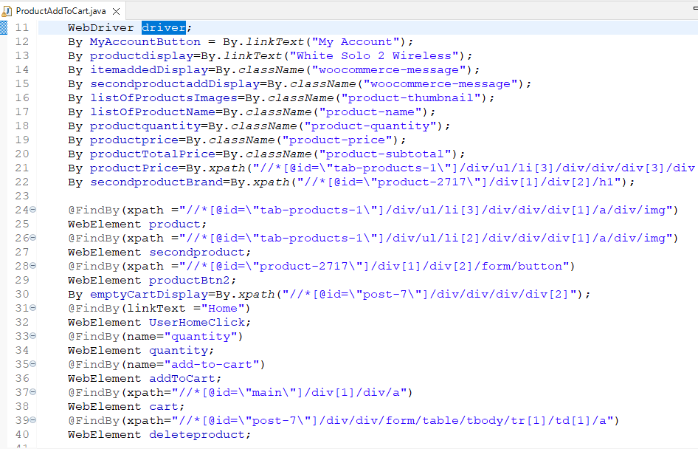
Test Scenario: Product Add to Cart
Test Elements
Product Quantity
View Cart
Add Product
Delete Product
TEST ELEMENTS
Notes:
This is the Object repository of webelements which is identified by name –click---, classname for item display---click--- ,classname for product quantity ---click----and xpath to remove product--click
I have used Findby command to return webelement to increase the product quantity by name.—click---
By class to return whether the item is displayed using className---click---
And To check the list of product items quantity---click
This is the action element to remove the products added in cart inspected using xpath.
Declaring WebDriver reference variable
inspected for the testcases.element locators like linktext, classname, xpath and name . Finding webelements using FindBy from Page Factory(objects are initialized using initelements methods), pom helps to find elements using By

Slide 21
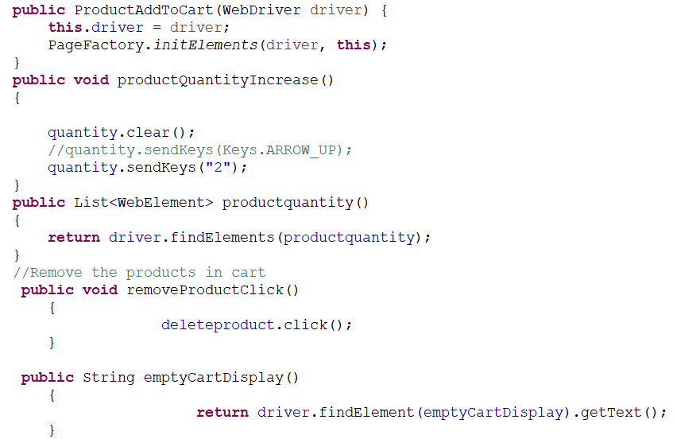
Test Scenario: Methods
Test Methods
Page Constructor
Page Factory
Page Methods
TEST ACTIONS
Notes:
This is the object repository for actions to perform on the elements I have identified
, a constructor to pass WebDriver as an input parameter.----click-------it, call initElements() method to initialize elements in the class.
the driver is initialized and pagefactory .
onscall initElements() method by using PageFactory object reference to initialize elements in the class.
tructor In Page Factory(all page objects are initialized using initelements method. These are some major actions involved in each testcase .

Slide 22
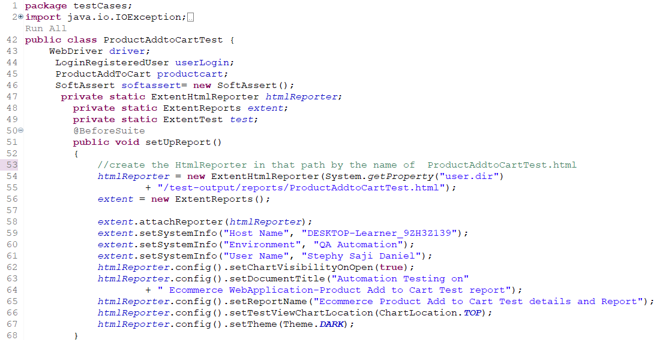
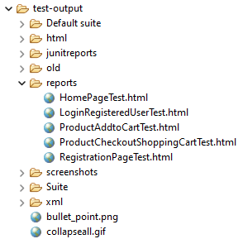
Test Scenario: Testcase
Test Implementation
Annotations
Extent Report
REUSABLE
PAGE OBJECTS
TEST IMPLEMENTATION
RUN BEFORE ALL TEST
EXTENT REPORTS
Notes:
I have used TestNG framework in this model ,which helps in test grouping and prioritizing. The Beforesuite method is used to create html report
test dependencies and

Slide 23
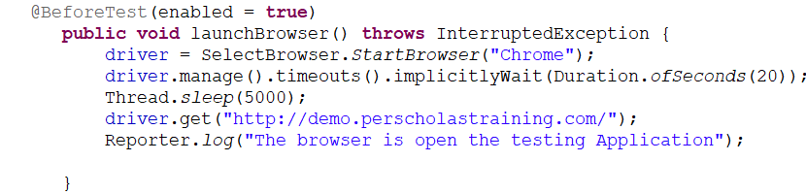
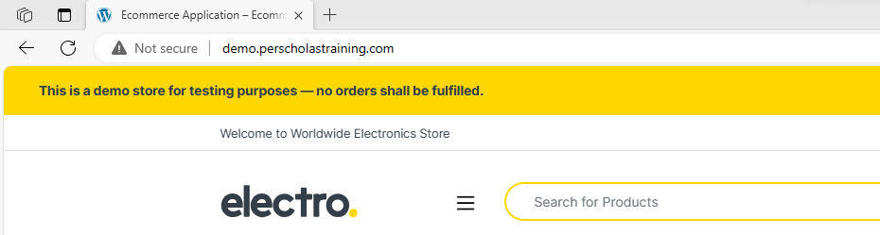
Test Scenario: Testcase
Test Implementation
Annotation
Extent Report
RUN BEFORE ANY TEST INSIDE A @Test TAG IS RUN
Notes:
In beforetest method ,configuring browser to chrome and url to execute test scripts ---click-----
Enabled true means you can choose to execute or skip the testcase execution
Thread.sleep will stop the execution of the script for the specified duration of time no matter whether the element is found or not.----
Implicit wait allows you to halt the webdriver for a particular period of time until elements are located by the webdriver---dynamic wait

Slide 24
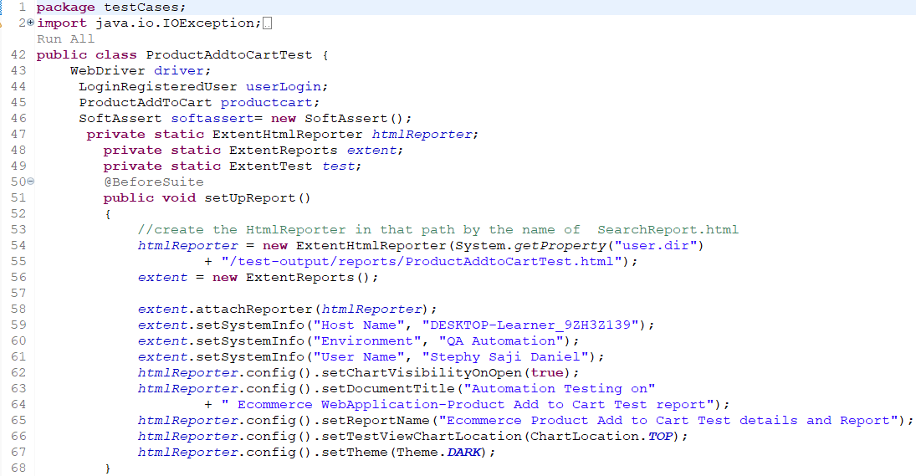
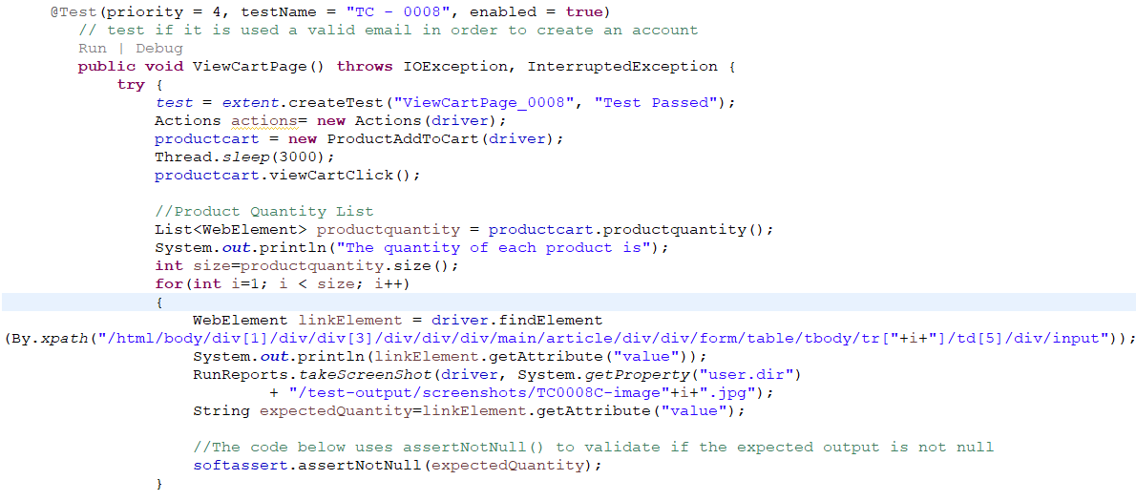
Test Scenario: Testcase
Test Implementation
Annotations
MARKS METHOD UNDER TEST
PRODUCT QUANTITY VALIDATION
Notes:
This was the 4th prioritized test execution in Product add to cart pages ---click----
In this test step I have used customized xpath to calidate if all products added are available in the cart. ----click----
**************** I have iterated the xpath, to verify if all objects in product list is available or not , and validated using assertnot null from softasserts********************************
*******driver is initialized and calls the method viewcartclick to perform its action.
where driver is initialized to productcart object
Here the @Test annotated method perform whether user can view the items in the cart or not .here I have iterated through the full xpath to verify if element added in cart for validation
Soft asserts are the asserts which continue the execution even after the Assert condition fails. Soft Asserts do not throw an Assertion error if there is any exception and rather record the failure.

Slide 25
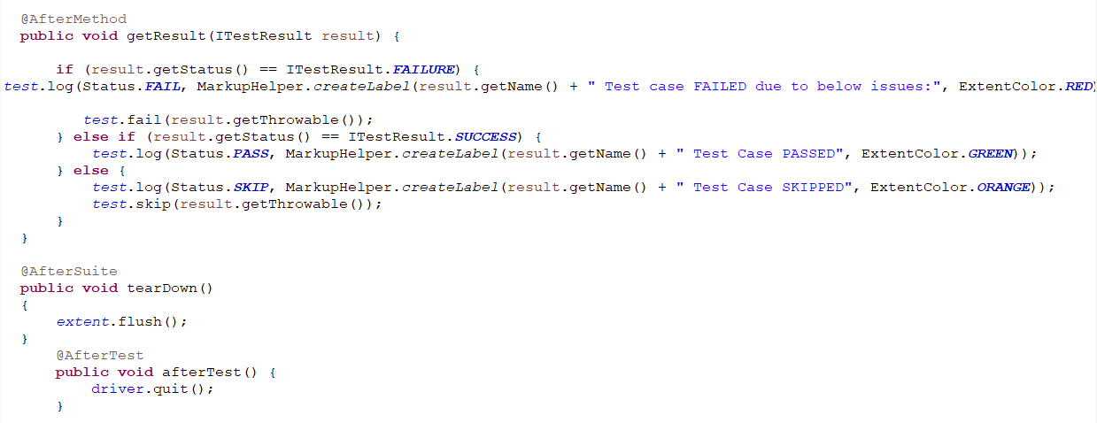
Test Scenario: Testcase Validation
Test Implementation
Annotation
METHOD RUNS AFTER EACH TEST METHOD
METHOD RUNS AFTER ALL TESTS IN SUITE HAVE RUN
Notes:
In aftermethod we get extent report logs and after suite method will append the test output data to html file

Slide 26
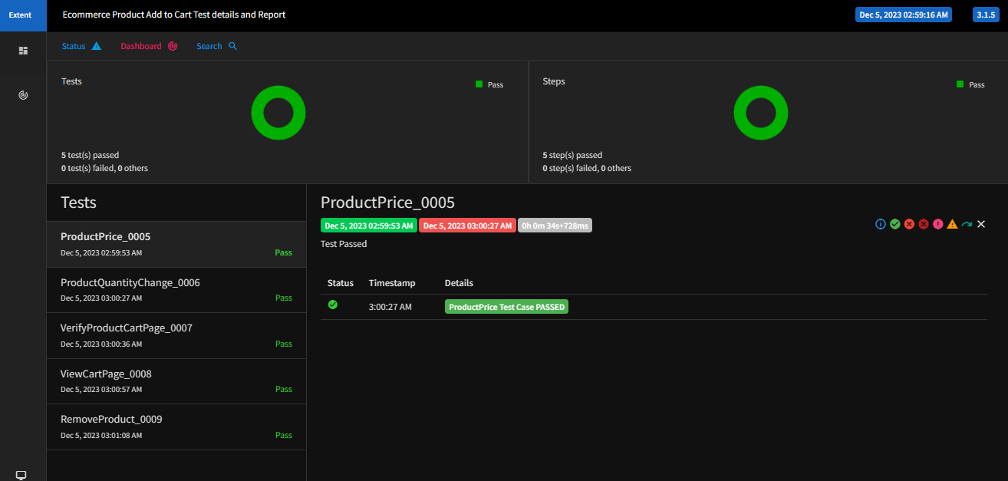
Test Scenario: Extent Report
Test Report
Extent HTML Report
METHOD RNS AFTER EACH TEST METHOD
TEST REPORT
METHOD RUNS AFTER ALL TESTS IN SUITE HAVE RUN
Notes:
Here is the Html report with dashboard for test scenario Add products to cart

Slide 27
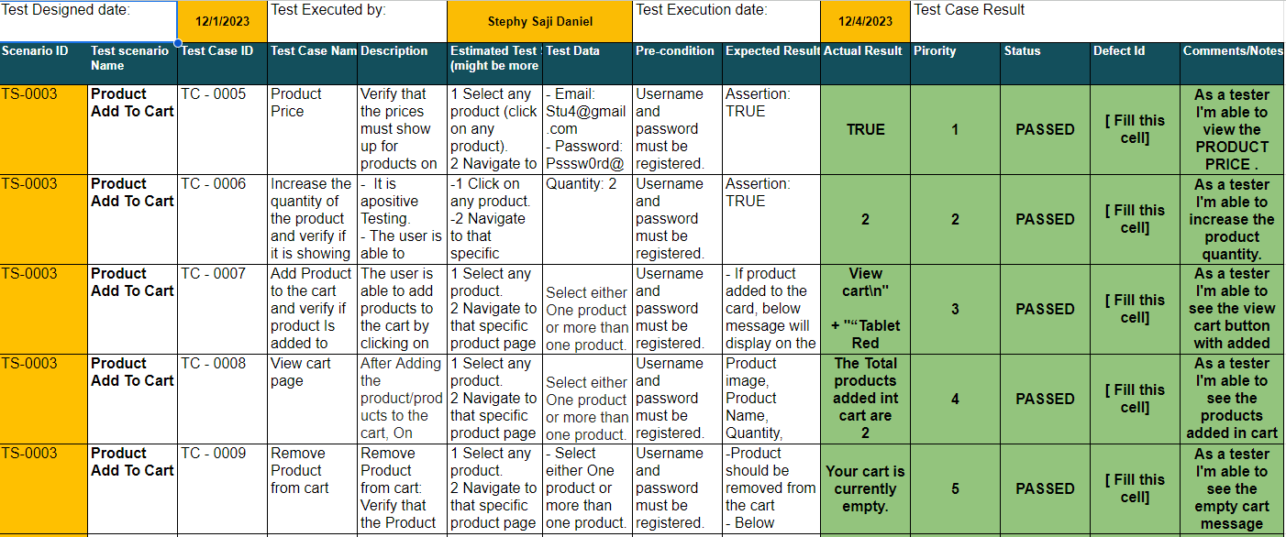
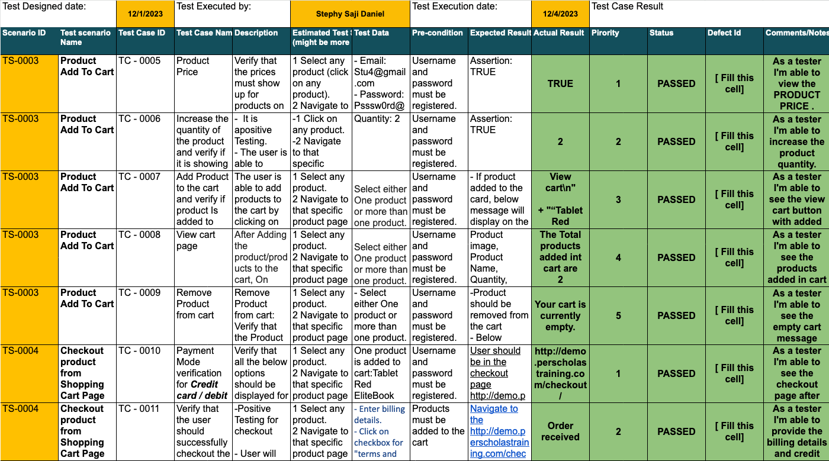
Test Results: Product Add to Cart
Notes:
Highlighted in green is the test results.

Slide 28
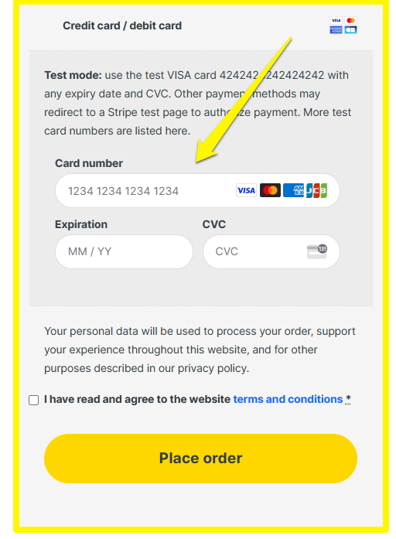
Test Scenario: Product Checkout
Scenario ID | Test scenario Name | Test Case ID | Test Case Name | Description | Estimated Test Steps (might be more or less) | Test Data | Pre-condition | Expected Result
TS-0004 | Checkout product from Shopping Cart Page | TC - 0011 | Verify that the user should successfully checkout the product | -Positive Testing for checkout - User will be able to add billing information and debit card and credit card information, credit/debitcard information is provided in the Test data column | 1 Select any product. 2 Navigate to that specific product page 3 Select product option (brand, quantity, size if display on screen) 4 Click on Add to Cart button. 5 Click on "View cart" button or View cart icon 6 Navigate to cart page 7 Click on "Proceed to checkout" button. 8 Navigate to checkout page (http://demo.perscholastraining.com/checkout/) 8 Enter Billing details. 9 Enter credit cart / debit cart information, that is provided in Test Data column. 10 Click on "terms and conditions" checkbox 11 Click on "Place order" button | - Enter billing details. - Click on checkbox for "terms and conditions". 1) Credit card number: 4242424242424242 2) Expiration date: 05/26 3) Security code: 222 | Products must be added to the cart | Navigate to the http://demo.perscholastraining.com/checkout/order-received page. The below message will show non that page. Order received
TEST ACTIONS
Login to the application
Add products in cart
Proceed to checkout
Notes:
In the second test scenario, user should be able to add credit/debit card details for placing an order .

Slide 29
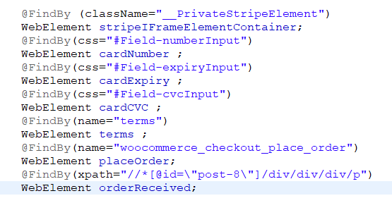
Test Scenario: Product Checkout
Product Checkout Page
Locators
Web Elements
TEST ELEMENTS TO PERFORM ACTION ON IFRAME
Notes:
Here elements in an iframe is identified by locators.
******These are the elements inspected to perform action on the payment section of the shopping cart pages It is identified by class name, css selector and xpath. The elements in the html page is in an iframe.

Slide 30
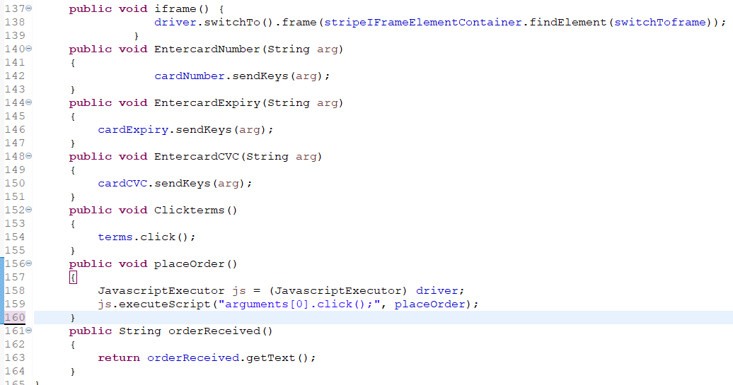
Test Scenario: Product Checkout
Test Methods
Elements in iframe
Java Script Executor
TEST LOGIC
Notes:
Inside iframe method, the driver will switch to the frame container and interact with the webelements to send the data . I have used executescript to click on place order.
element to enter the payment details to place an order.The action to performed on the card details is passed on to the web elements . Here I have used java script executor to click on placeorder button .---click

Slide 31
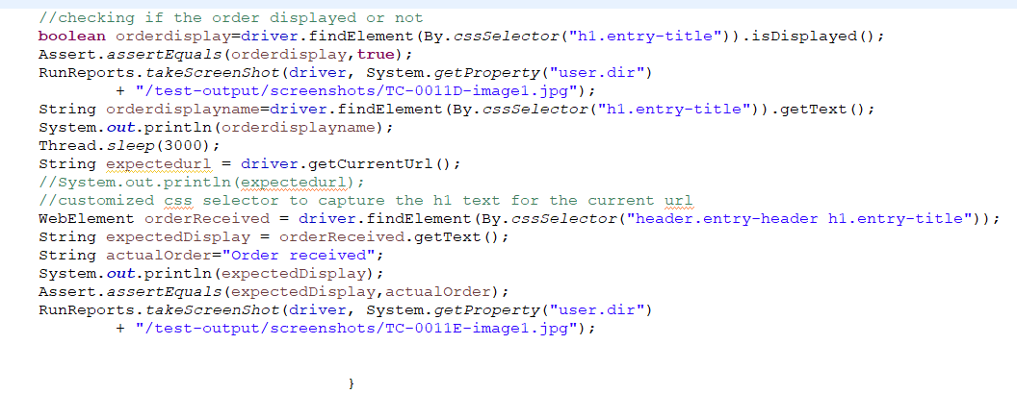
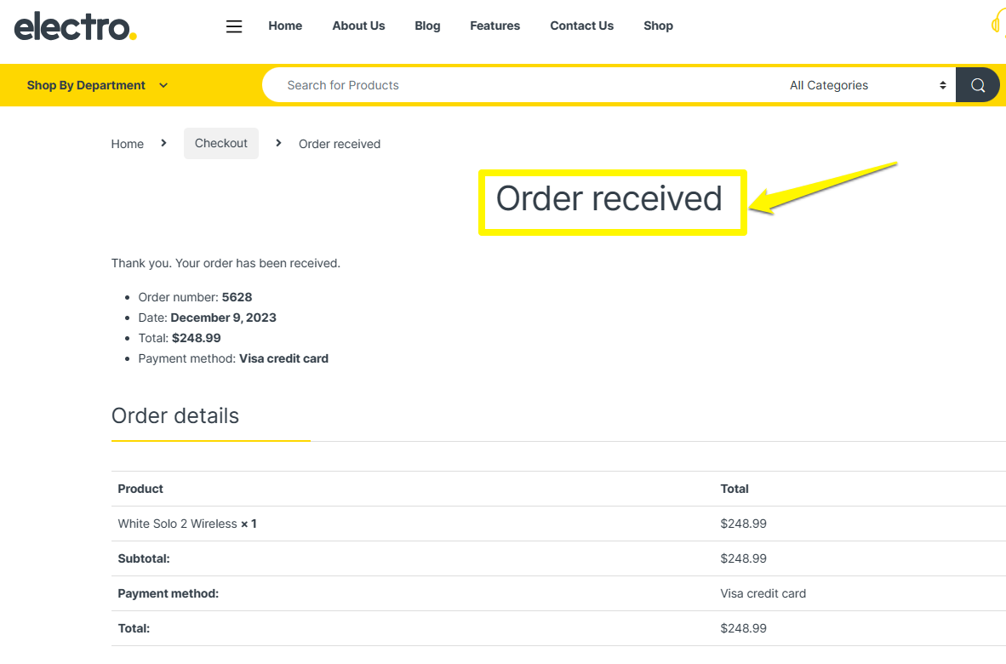
Test Scenario: Product Checkout
Test Case
Custom made cssSelector
Screenshots Captured
TEST IMPLEMENTATION
Notes:
I have used customized css selector to verify the order received is displayed.---click----

Slide 32
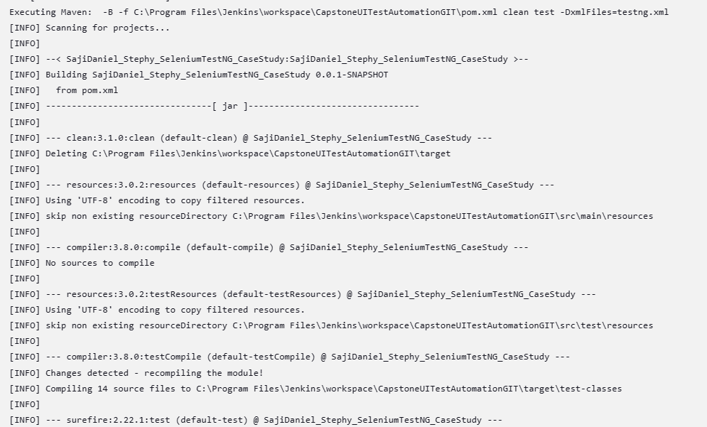
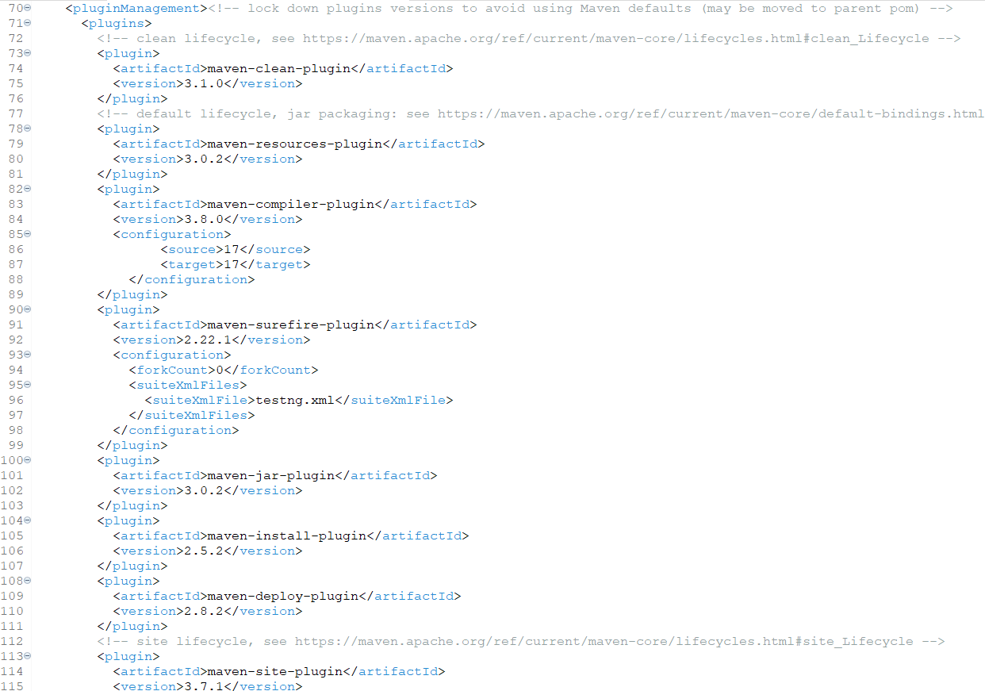
Test Dependencies: POM.xml
Test Build Configuration for Maven
Plugin Management
Test Dependencies
Build Dependencies
BUILD CONFIGURATION
Notes:
This is POM.xml file where maven dependencies and plugins are configured to trigger the build.-----click
maven will clean, compile, integrate with testNG using the dependencies ---click, it will select & execute suite in testing.xml file---click
This is the build configuration for the test where all the dependencies are installed from web

Slide 33
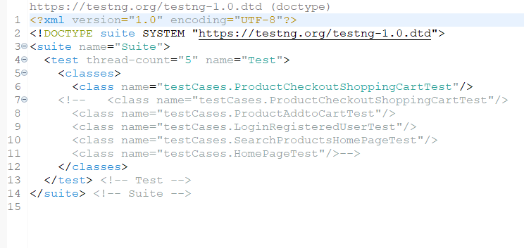
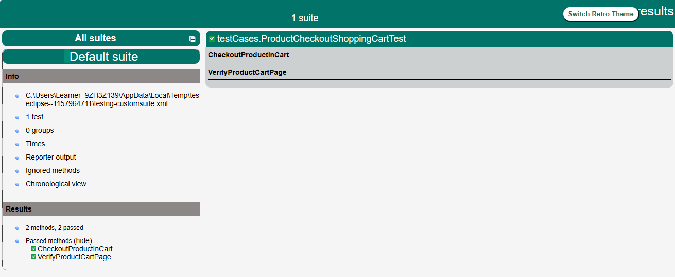
Test Framework: TestNG.xml
Test Automation
Test Suite
Test Classes
Test Scripts
TEST CONFIGURATION
TESTNG REPORT
Notes:
The tests are grouped into testsuite . This is testNG report for product checkout shopping cart test.
******We can select the testcase or run test in parallel .

Slide 34
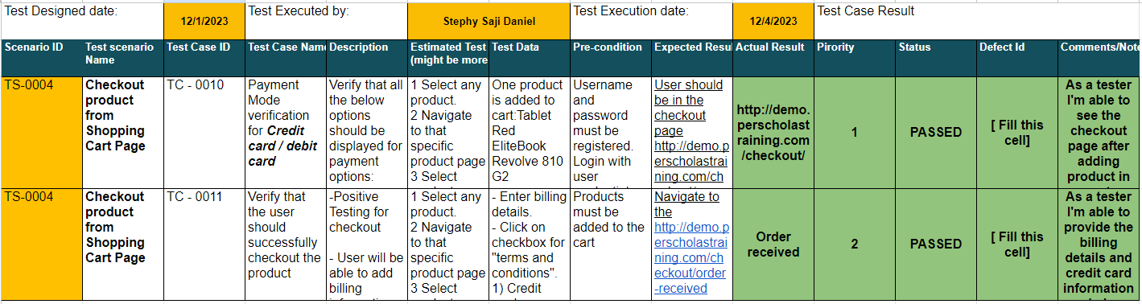
Test Results: Product Checkout
Notes:
Highlighted in green is the test results for the executed test scenario

Slide 35
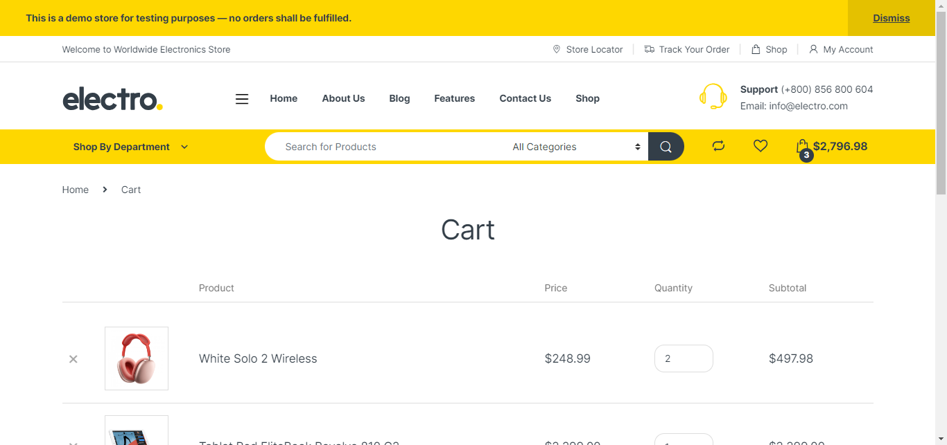
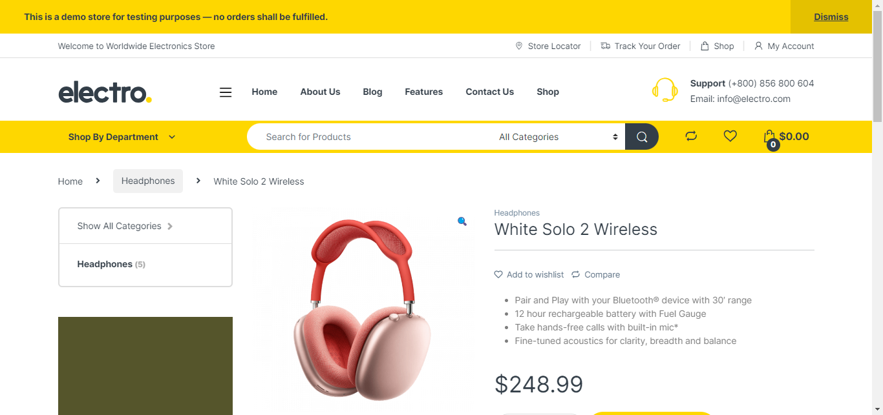
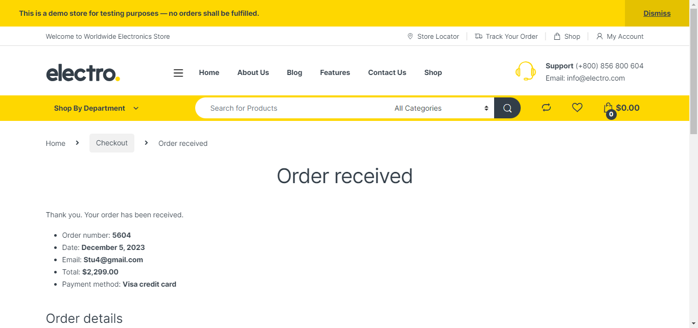
Test Output: Screenshot
Screen shots captured for product add to cart.
TEST OUTPUT
TC-0005A-image1.jpg
TC0005B-image1.jpg
TC0005C-image1.jpg
TC0006A-image1.jpg
TC0007A-image1.jpg
TC0007B-image1.jpg
TC0008A-image1.jpg
TC0008B-image1.jpg
TC0008C-image1.jpg
TC0008C-image2.jpg
TC0008D-image1.jpg
TC0008E-image1.jpg
TC0009-image1.jpg
Notes:
Screenshots captured during test

Slide 36



Test Execution: Pipeline
End to End Testing
TRIGGERS
DEVELOPER
PUSH &PULL
TRIGGERS
Notes:
I will be doing an end to end testing where the source code is pushed to git and build triggered from jenkins

Slide 37
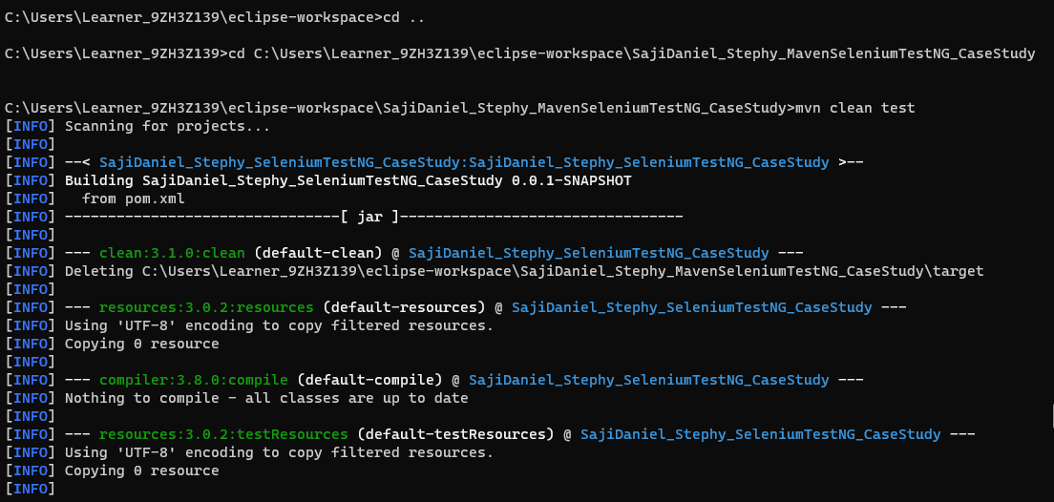
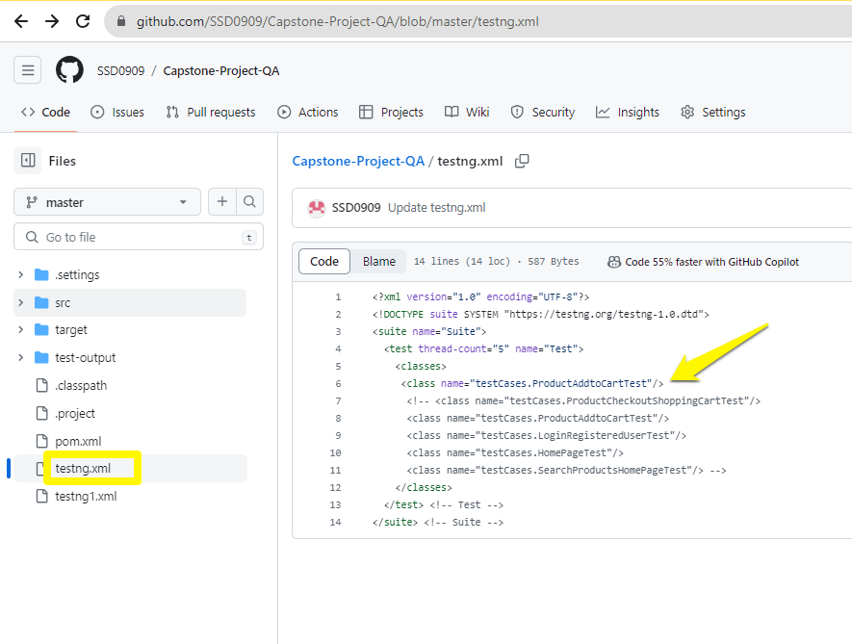
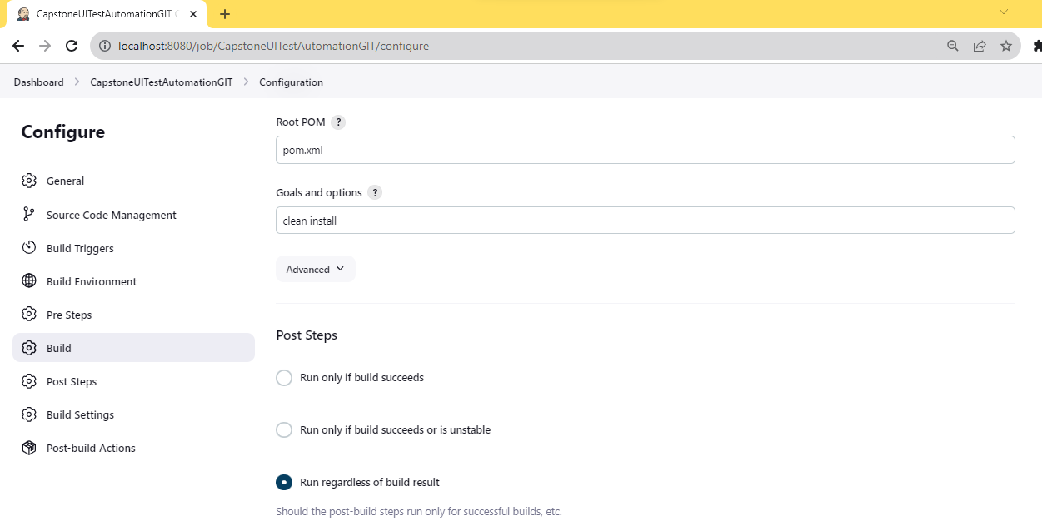
Test Execution: Pipeline
Source code pushed to Capstone-Project-QA repository
1st Test Scenario from Jenkins build Trigger
2nd Test Scenario from Command Prompt Apache Maven build trigger
TC-0005A-image1.jpg
TC0005B-image1.jpg
TC0005C-image1.jpg
TC0006A-image1.jpg
TC0007A-image1.jpg
TC0007B-image1.jpg
TC0008A-image1.jpg
TC0008B-image1.jpg
TC0008C-image1.jpg
TC0008C-image2.jpg
TC0008D-image1.jpg
TC0008E-image1.jpg
TC0009-image1.jpg
DEMO
Notes:
This is my Git repository and highlighted is the xml file ---click ---here I have integrated Jenkins with maven to trigger the build.---the second scenario demo is from command prompt.

Slide 38
CHALLENGES
RESOURC
Version compatibility
Choosing the right test approach
Understanding the plugins and dependencies
Notes:
These are some challenges I have faced
Mav
Jdk version upgraded from 1.8-17 to run testng 7.4.0 version,perscholas

Slide 39
RESOURCES
Per Scholas Training documents and GLABS
Stack-over flow
Browser Stack
You Tube videos
Notes:
These are the resources that helped me to troubleshoot and learn .

Slide 40
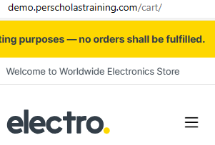
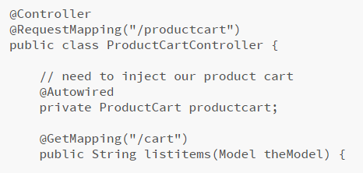


Postman :Application Programming Interface
APPLICATION LAYER
API
LAYER
DATABASE
LAYER
Unit Testing using Postman
CRUD operations performed before testing.
Create-POST
Read-GET
Update-PATCH
Delete-DEL
DESKTOP BOWSER
HTTP Request
BUSINESS
LOGIC
DATABASE
HTTP Response
Status code
API
MOBILE/
TABLET APP
HTTP Request
HTTP Response
Status code
API end point
Notes:
Beyond User Interface testing, api testing validates backend functionality from internet.The cart endpoint in ecommerce webapplication is an http request end point and postman carries this end point and validates the response.
*********allows to validate the backed functionality directly from internet using end points .
********The api end points written in business service layer communicates with backend and return the list of http response back.
---This is the requirements document for simple tool application—click----To get the status of api----click----the request response code as 200 ok, there are the CRUD queries I have performed. All the test are stored in API collection
Click--------------------------

Slide 41

API Testing :Postman
API Unit Testing using Postman
Simple Tool Rental API test
CRUD operations performed before testing.
Create-POST
Read-GET
Update-PATCH
Delete-DEL
baseURL1
BaseURL1
API REQUIREMENTS DOCUMENTATION
End points
API End points
Notes:
This is the API requirements document and we will be performing actions on the base url using endpoints

Slide 42













API Testing :Postman
Notes:
Status end point checks if the api is up ---click---and receives a 200 okay---click
To get all tools will return an arraylist of tools---click---response 200 ok---click
Getting single tool details---click---response 200 ok---click
Trying to post an order from client to server giving 400 bad request on client ---click
Creating an api token to get authorized to post ---click
Creating an order--- response 201 created---click
Get all orders---click
Update an order ---204 no content ----click
Delete an order----404 not found ----tool rental api is the collection created—Lets see how performance testing can be done
test the response on end points. To find the status using get---click-testing it using postman
Get all tools , provides list in json format --click ----getting single tool-------click---
Trying to create orders giving 400 bad response-----click—click
Creating access token and added to the –click ----bearer token to accesss database to create orders
Status is 201 creted---- click---to update tge order---using json format deleting ---click

Slide 43




Performance Testing: JMeter
JMeter Test Plan
Thread group
Sampler--Http Request
Listener
View Results Tree
Aggregate graph
Response time graph
View results in table
Simulates
Request 1
Simulates
Request 2
Thread Group
Application under Test
Number of Threads/Users(50)
Request 50
Simulates
Notes:
To determine the performance of the application , Jmeter threads sends http request using sampler and listener to create graphs and analysis on response time

Slide 44





Performance Testing: JMeter
Single User Thread group
Ramp up time 10s
Response time 30s
HTTP request from PerScholas ecommerce website
Single User Response Time
Notes:
Here we will find the response time for single user login to the perscholas website---click ----this is the results tree with response code---click---results in table format----click----This is aggregate graph showing statistical analysis of average response time is 7.75 seconds

Slide 45





Performance Testing: JMeter
50 User Thread group
Ramp up time 10s
Response time 30s
HTTP request from PerScholas ecommerce website
50 User Response Time
Notes:
When the number of users are increased to 50 with ramp up period 10 seconds and---click– click---results tree for single iteration ---. this is holistic view for 50 users , average sample response time for all the requests in the test is 32.99 seconds.—click--- This response graph shows there is drop in http request response after 4.7sec

Slide 46
Back-end Layer
Notes:
Next I will walkthrough the learnings and implementation on backend layer

Slide 47

MySQL Learnings: Implementation
School Database
Course
Faculty
Department
Student
Conjunction tables for faculty & department
Notes:
This is an Entity Relationship diagram for school database

Slide 48


MySQL Learnings: Implementation
Faculty are awarded bonuses based on the progress made by students in their courses.
List faculty name and the average progress of their all their courses.
Notes:
Here I need to get the faulty firstname and last name based on student avg progress.I have used multi joins on faculty table and group by and order by clause--click---

Slide 49


MySQL Learnings: Implementation
Students are awarded two grades based on the minimum and maximum progress they are making in their courses.
Minimum and Maximum grade for students
Notes:
I have used case statements to find min and maximum grade based on their marks ---click

Slide 50


JDBC Learnings: Implementation
Stock Marketing POC
One to many relationship
Database creation using CRUD queries.
Notes:
I have created a POC on stock marteing with three tables stocks, traders and conjunction table trade.

Slide 51






JDBC Learnings: Implementation
Business Logic implementation Layer
Object creation phase to insert the stocks data into the database using save method.
Creating a blueprint for Stocks, Traders and Trade
Encapsulation concept applied for the class variables /instance variables
Getters and Setters method to access the variables
Requirement Analysis phase
Created an Interface for Stocks, Trades & Traders
Connecting Business layer with Database layer using JDBC
Creating Connection DAO to connect with MySQL server
Notes:
This is the interface for abstract methods to access database .---click---click
A blue print to create stocks----click
JDBC connection layer ---click
Interface method implementation ---click
Aceesing the database to insert data----click

Slide 52




JDBC Learnings: Implementation
Inserting the records from Business logic layer to Back-end layer
Notes:
The data injected successfully---click---click----click---click----

Slide 53
Business-Logic Layer

Slide 54

Java Learnings: Implementation
Check whether a String is Pangram or not
Notes:
Using character array verifying the given string is pangram or not
String is immutable , string is converted to a character array and a new array with 26 elements are created with 0 as value using while loop iterating to the size of the array and index of the b array is changed to 1 when the a[i]-65---65 is acii value of capital A

Slide 55


Java Learnings: Implementation
USER STORY
Users need to add an Account in a Bank Application
BANK APPLICATION
BANK
BANK ACCOUNTS
Notes:
Implementing java compositions in a banking application ----click
If a user provides a choice to add an account internally it connects with a bank object

Slide 56





Java Learnings: Implementation
Receives request from User
User to add an account
Bank application connects with bank
Bank connects with Bank Account to perform its actions
Bank Account Objects Creation
Bank Account number
Bank Account Name
Manual testing on Bank Application.
Notes:
Bank object will then adds the account if it doesn’t exists---click
Inturn calls a search method to iterate through the accounts in the list---click
---blue print to create bank accounts and other functionalities---click
Bank account object creation ---click
Positive and negative Testing performed on adding an account---click

Slide 57
Software Testing

Slide 58


Testing Learnings: Implementation
White-Box Testing using Junit
Notes:
Thi is how to perform junit testing performed on the methods ---click---using assertequals method---click

Slide 59
Front-End Layer

Slide 60

Web development :Implementation
Implementation of frontend technologies
in creating My Portfolio
My Portfolio
Notes:
This is My portfolio I have created using HTML CSS and Javascript learnings

Slide 61



Deconstructing the Web
HTML
Creating structure to contact page of My Portfolio
CSS
Adding style to MyContact.html Page
Java Script
Adding interactivity to the front-end user
Notes:
This is the html code for the message box in contact html page---click----, styling used in connect container----click---- and javascript to show the greeting message---click----

Slide 62
Special Thanks
Technical Trainer
OCC leaders
Roger Boaitey
Nick Grossi
Dave Martin
Professional Developer
OCC Talent Acquisition Manager
Jason Cancino
Zephaniah Manning
Junior Technical Trainer’s
Darnell Champen & Calvin La
Notes:
Expressing my sincere gratitude to my dedicated trainers for invaluable guidance .Heartfelt thanks to the OCC leaders & the Career advancement manager who supported throughout my training journey.

Slide 63

Thank you
Notes:
Thankyou for your time

